Slide 1


‘Embedding and Aligning’ – Expanding Our Thinking on Improving Reading Outcomes
Sharon Vaughn, Ph.D.
The Meadows Center for Preventing Educational Risk
The University of Texas at Austin
Special Recognition to: Dr. Elizabeth Stevens and Dr. Garrett Roberts

Slide 2
How to Intensify Intervention
Change Dosage or Time
Change the Learning Environment to Promote Attention and Engagement
Combine Cognitive Processing Strategies with Academic Learning
Modify Delivery of Instruction
(Vaughn et al., 2013)
Notes:
Today’s conversation will be organized about ways to intensify intervention along the following four dimensions.
first and second dimensions already occur frequently in your school. These are typically the most common methods of intensification.
We’ve called these quantitative changes to instruction in prior modules. Quantitative changes typically refer to changes that increase the amount of instruction a student receives.
The third and fourth dimensions are consistent with qualitative changes, or adaptations that change the method or content of instruction/intervention delivered. We’ll spend time discussing each of four dimensions now, but will spend most of the time on dimensions three and four because you may be less familiar with them.
To read more, see: Vaughn, S., Wanzek, J., Murray, C. S., & Roberts, G. (2012). Intensive interventions for students struggling in reading and mathematics: A practice guide. Portsmouth, NH: RMC Research Corporation, Center on Instruction. Retrieved from http://www.centeroninstruction.org/files/Intensive%20Interventions%20for%20Students%20Struggling%20in%20Reading%20%26%20Math.pdf.

Slide 3
The Problem
Intervention studies have yielded small to negligible effects on improving reading comprehension for students with reading difficulties (e.g. Connor et al, 2018; Goldman, Snow, & Vaughn, 2016; Lonigan, Burgess, & Schatschneider, 2018; Scammacca et al., 2016; Vaughn et al, 2013; Wanzek et al., 2013).
NAEP data suggest more than half of students are unprepared to read and understand grade level texts (NCES, 2019)
Reading comprehension practices applied inconsistently and infrequently in classrooms (Swanson et al., 2016)
  Teachers rarely provided high quality vocabulary instruction
  Teachers frequently built background knowledge, but low quality
  Little time spent reading text

Slide 4
Typical Tier-2 intervention is not aligned to Tier 1 instruction
Tier 1
Non-aligned Intervention
Content
Skills
Teacher
Language
Tier 2 Intervention
Notes:
Multi-tiered systems of support, students receive small group intervention in addition to their whole class instruction
May be provided by a different teacher, address different content, not aligned or connected to whole class
Intervention that is not aligned – causes problem in that time in T1 is less meaningful for students, less aligned --- generalization is even more difficult
Compartmentalized, lacks cohesion across the tiers that could maximize instruction intensity

Slide 5
Reading comprehension instruction is typically compartmentalized
Schools have difficulty identifying time in the day to provide more intensive intervention
Many schools do provide Tier 2-type intervention (less intensive)
Aligned instruction may provide a more cohesive and integrated instructional model that could maximize intensity of instruction

Slide 6
We wondered…
What if we provided aligned instruction for students with reading disabilities and reading difficulties?
How might that impact students’ reading performance?

Slide 7
Our hypothesis: Aligned Tier 1 and Tier 2 instruction
Accelerates learning
Supports generalization of skills across settings
Provides additional practice opportunities
Eliminates the guess work for students
Improved reading comprehension and vocabulary understanding

Slide 8
Previous research on aligned intervention studies
Fien et al. 2015
  Aligned reading practices in Tiers 1 and 2 for first graders
  Positive, statistically significant outcomes on ORF and nonsense word reading
Scanlon et al. 2008
  PD Interactive Strategies Approach (ISA), Tier 2 intervention in ISA, combined PD and Tier 2 in ISA on preventing reading difficulties for at-risk kindergartners
No studies have examined the coordinated implementation of comprehension and vocabulary practices in Tier 1 and Tier 2 instruction for struggling readers in Grades 4 through 12
Notes:
Few studies at the elementary grades examining aligned Tier 1 and Tier 2 approaches

Slide 9


How did we align the Tier 2 intervention to Tier 1 instruction?
 | Tiers | Example of alignment in Instructional Practices
Tier 1 | STRIVE whole-class lessons 2x/week | Get the Gist introduced in one lesson Guided practice with the teacher over several lessons Practice writing gists with a partner
Tier 2 | I-STRIVE INTERVENTION 3x/week | Students learned the same practice Skill broken into smaller steps across several weeks of instruction Repeated opportunities for practice with feedback in a small group setting Frontloading
Notes:
In the intervention, students learned step.1 of gist and practice that for a few lessons, then they learned step 2, then they practiced combining these steps
Focus on fix-up practices
For questioning, each question type was introduced on a separate day; interleaving of the question types across the 6 weeks

Slide 10
Research Design and Participants
 | ALIGNED | NOT ALIGNED | BAU
Tier 1 | STRIVE whole-class lessons 2x/week | BAU social studies instruction 2x/week | BAU social studies instruction
Tier 2 | I-STRIVE INTERVENTION 3x/week | I-STRIVE INTERVENTION 3x/week | BAU, school-provided intervention (if any)
 | 4 schools ~48 students | 5 schools ~46 students | 3 schools ~42 students
Notes:
What is the effect of a Tier 1 content are reading instruction in social studies combined with a highly aligned Tier 2 reading intervention compare to a BAU condition on students’ vocabulary, content knowledge, and reading comprehension?
What is the effect of a Tier 2 reading intervention NOT aligned to Tier 1 content area instruction compared with a BAU condition on students’ vocabulary, content knowledge, and reading comprehension?
Conducting a quasi-experimental design study in 12 elementary schools
Students were identified as struggling readers – recruited from 12 campuses
Change headers – aligned, misaligned, BAU

Slide 11
Identifying Struggling Reader Participants
Students who did not pass the previous year's high stakes assessment
305
Parental consent
195
Up to 50 per condition; randomly selected students from consented students
48 Aligned T1-T2
49 non-aligned T2
50 BAU
Students attending 12 elementary schools in the same district

Slide 12

Build Background Knowledge | Unit 1 | Unit 2 | Unit3
Tier 1
Tier 2
State unit big idea
Connect new learning to past learning
Build knowledge using the visual, explaining new information, asking questions

Slide 13
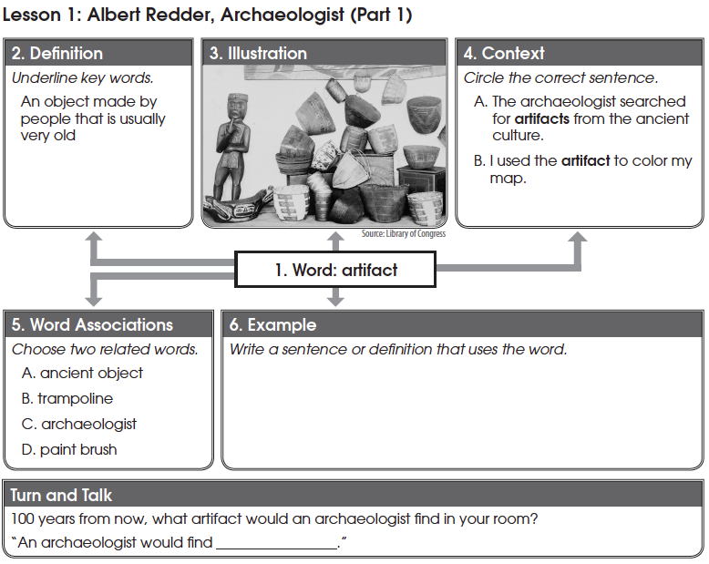
Explicit Vocabulary Instruction | Unit 1 | Unit 2 | Unit3
Tier 1
Tier 2
Notes:
Teacher led (top half), student-lead (bottom half)
Introduce words, provide student friendly definition, visual that helps students remember the meaning of the word, identify correct use of the word in context

Slide 14
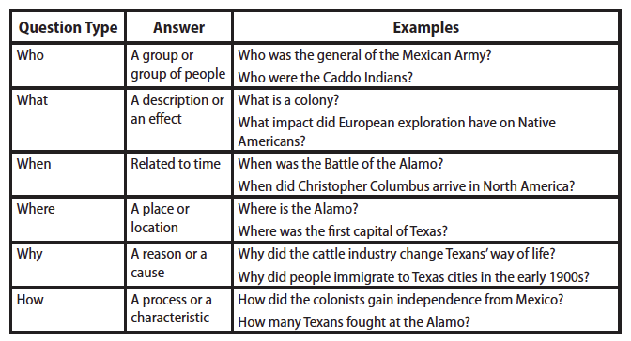
Text reading with questioning | Unit 1 | Unit 2 | Unit3
Tier 1
Tier 2
Notes:
Repeated reading routine, Questions after each section of text

Slide 15
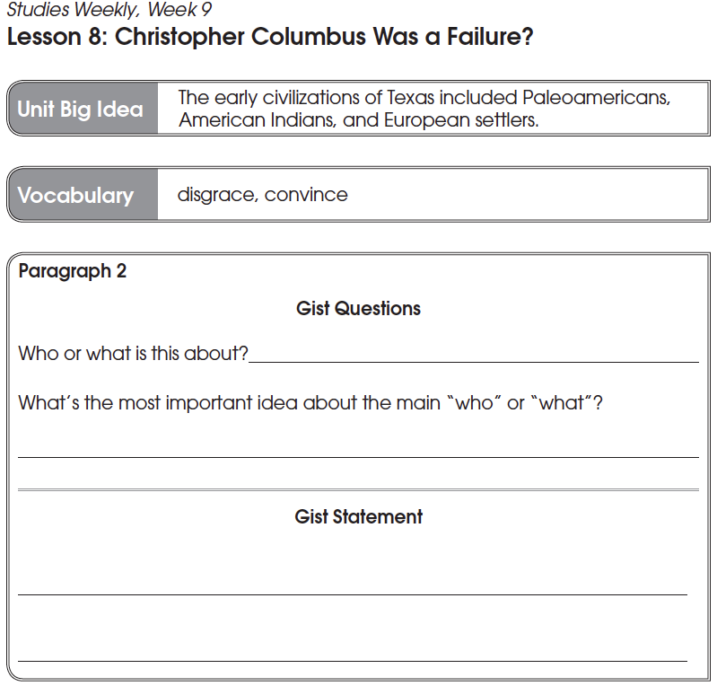
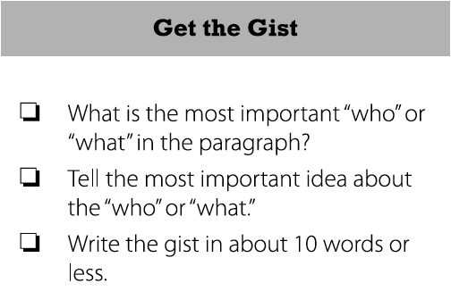
Generating GIST statements | Unit 1 | Unit 2 | Unit3
Tier 1
Tier 2

Slide 16
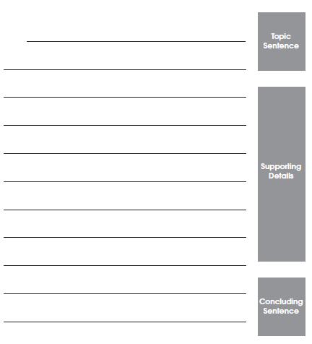
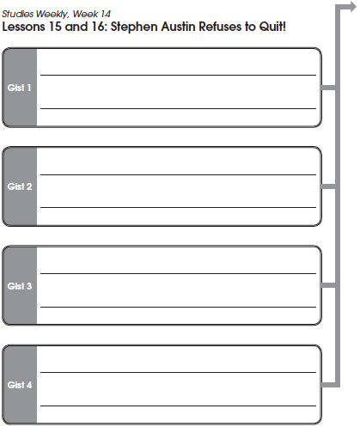
Gist to summary | Unit 1 | Unit 2 | Unit3
Tier 1
Tier 2
Tier 1 lessons only (not present in the intervention lessons due to time)

Slide 17
Measures
Measure | Type | Administered
 |  | Pre-test | End of Unit 1 | End of Unit 2 | End of Unit 3 | Post-test
Unit tests of content knowledge | Proximal |  | X | X | X
Unit tests of vocabulary knowledge | Proximal |  | X | X | X
Strategy Use Measure (SUM) | Proximal | X |  |  |  | X
Content reading comprehension | 'Midstal’ |  | X | X | X
GRADE Passage Comprehension subtest | Distal | X |  |  |  | X
GMRT-Vocabulary | Distal | X |  |  |  | X

Slide 18
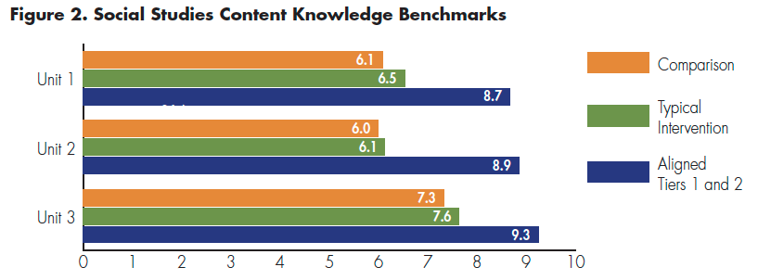
Results
Content Knowledge | Aligned T1-T2 M (SD) | Non-aligned T2 M (SD) | BAU M (SD) | Aligned T1-T2 vs. BAU g (SE) | Non-aligned T2 vs. BAU g (SE)
Unit 1 | 8.67 (3.52) | 6.54 (2.68) | 6.09 (3.09) | 0.77* (0.21) | 0.15 (0.21)
Unit 2 | 8.85 (3.21) | 6.13 (3.33) | 6.00 (2.41) | 0.99* (0.22) | 0.04 (0.21)
Unit 3 | 9.25 (4.29) | 7.63 (3.45) | 7.33 (3.17) | 0.50* (0.21) | 0.09 (0.21)
Notes:
Analysis:
Complex due to the multi-level structure of the data
Tier 1 assignment school level
Students were nested in schools, intervention students nested within teachers (Tier 1) and tutors (Tier 2)
Small sample size and limited number of students within each unit at each level (1-2 students per teacher in some cases)
Given this and it being pilot study work, we analyzed using repeated measures ANOVA (for measures administered pre and post)
For measures administered only at post-test, used ANOVA, followed up with pairwise comparisons
Used Benjamini-Hochberg procedure for controlling false discovery rate (critical p value .031)

Slide 19
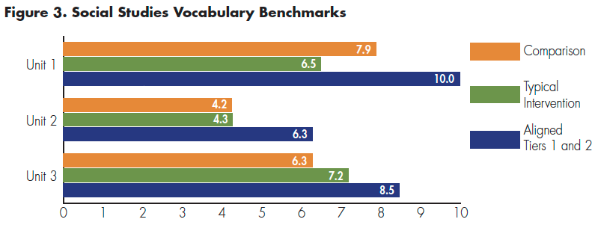
Results
Content Vocabulary | Aligned T1-T2 M (SD) | Non-aligned T2 M (SD) | BAU M (SD) | Aligned T1-T2 vs. BAU g (SE) | Non-aligned T2 vs. BAU g (SE)
Unit 1 | 9.98 (5.20) | 6.49 (4.10) | 7.87 (3.84) | 0.45* (0.22) | - 0.34 (0.22)
Unit 2 | 6.27 (3.27) | 4.26 (2.49) | 4.24 (2.83) | 0.65* (0.22) | 0.01 (0.21)
Unit 3 | 8.46 (4.76) | 7.17 (4.20) | 6.28 (3.74) | 0.50* (0.22) | 0.22 (0.22)

Slide 20
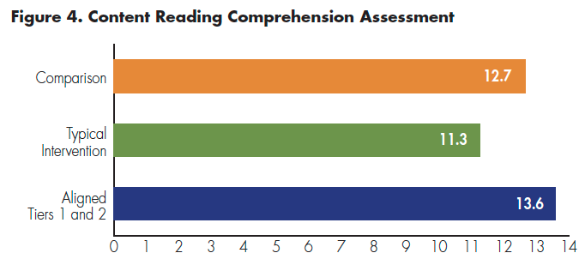
Results
Aligned T1-T2 M (SD) | Non-aligned T2 M (SD) | BAU M (SD) | Aligned T1-T2 vs. BAU g (SE) | Non-aligned T2 vs. BAU g (SE)
13.60 (4.68) | 11.26 (3.63) | 12.66 (4.45) | 0.20 (0.21) | - 0.34 (0.21)

Slide 21
Results
SUM | Aligned T1-T2 M (SD) | Non-aligned T2 M (SD) | BAU M (SD) | Aligned T1-T2 vs. BAU g (SE) | Non-aligned T2 vs. BAU g (SE)
Pre-test | 3.54 (3.22) | 3.40 (3.70) | 3.47 (3.70) | 0.02 (0.21) | - 0.02 (0.21)
Post-test | 6.65 (4.83) | 5.26 (4.51) | 7.23 (4.97) | - 0.19 (0.21) | - 0.47 (0.22)
GMRT Vocabulary | Aligned T1-T2 M (SD) | Non-aligned T2 M (SD) | BAU M (SD) | Aligned T1-T2 vs. BAU g (SE) | Non-aligned T2 vs. BAU g (SE)
Pre-test | 409.75 (35.01) | 414.29 (29.77) | 416.18 (30.29) | -0.20 (0.20) | -0.06 (0.20)
Post-test | 420.71 (39.11) | 428.43 (28.62) | 428.38 (29.53) | 0.00 (0.21) | 0.12 (0.21)
Notes:
No statistically significant differences among students in 3 conditions at pre-test
Effect sizes at pre-test reflected higher scores for the BAU group on the GRADE and GMRT Vocabulary measures (ranged from -0.22 to -0.06)
Given the effect sizes for the differences at pre-test on the GRADE and GMRT Vocabulary assessments, we used RM-ANOVA to compare growth from pre-test to post-test across conditions in order to address our research questions regarding treatment effects for the aligned T1-T2 condition vs. the non-aligned T2 condition.

Slide 22
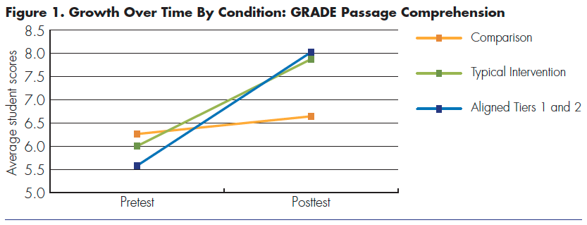
Results
GRADE | Aligned T1-T2 M (SD) | Non-aligned T2 M (SD) | BAU M (SD) | Aligned T1-T2 vs. BAU g (SE) | Non-aligned T2 vs. BAU g (SE)
Pre-test | 5.58 (4.08) | 6.00 (3.78) | 6.37 (3.15) | - 0.22 (0.20) | - 0.11 (0.20)
Post-test | 8.02 (3.92) | 7.87 (3.89) | 6.64 (4.48) | 0.42 (0.21) | 0.31 (0.21)

Slide 23
Discussion
Students in the aligned condition outperformed students in the non-aligned and BAU conditions on reading comprehension, content knowledge, and vocabulary outcomes
ES range 0.45 to 0.99
No significant differences at post-test on content reading comprehension, GMRT vocabulary, or GRADE reading comprehension.
ES on GRADE Aligned vs. BAU 0.42; potentially promising
Preliminary support for the benefits of aligning T1 and T2 instruction for students with RD

Slide 24
Students in the aligned condition outperformed students in the non-aligned and BAU conditions on reading comprehension, content knowledge, and vocabulary
ES range 0.45 to 0.99
Possible explanations
Frontloading improves access to Tier 1
Students in non-aligned condition did not significantly outperform BAU
Students in Aligned T1-T2 received twice the instructional time in Tier 1 compared to non-aligned and BAU settings

Slide 25
Limitations and Next Steps
Small sample size posed limitations for analysis; larger RCT with sufficient power to use a multi-level approach
Feasibility of this approach (coordinated effort, personnel, instructional time)
  In spite of this, the longstanding pattern of null findings or small effects in reading comprehension research warrants examining alternative models for supporting students with RD
Future intervention research should report implementation fidelity data on Tier 1
  Better understand the extent to which tiers align
  Contextualize findings
View Tiers 1 and 2 as coordinated instruction rather than separate pieces of the puzzle

Slide 26
Questions?

Slide 27
Examining the Effects of an Integrating Reading and Anxiety Management Intervention
Funding support:
National Institute of Health, Eunice Kennedy Shriver National Institute of Child Health & Human Development, 1R01HD087706

Slide 28
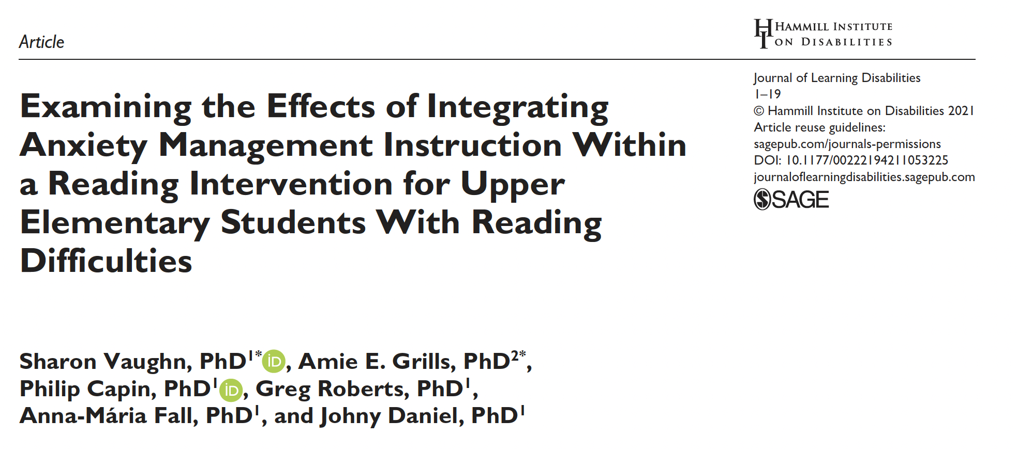
Article in JLD

Slide 29
Primary Research Question
What were the effects of an integrated reading and anxiety management intervention (RANX) relative to a reading and math (RMATH) and business-as-usual instruction (BAU) on the reading and anxiety outcomes for students at risk for reading difficulties in the upper elementary grades?
29

Slide 30
Primary Research Question
What were the effects of an integrated reading plus anxiety management intervention (RANX) relative to reading plus math (RMATH) and business-as-usual instruction (BAU) for students at risk for reading difficulties on reading and anxiety outcomes?
30

Slide 31
Primary Research Question
What were the effects of an integrated reading plus anxiety management intervention (RANX) relative to reading plus math (RMATH) and business-as-usual instruction (BAU) for students at risk for reading difficulties on reading and anxiety outcomes?
31

Slide 32
Sample
Grade 3 and 4 Students At Risk for Reading Difficulties (n = 128)
Scored Below the 30th on GMRT Reading Comprehension Subtest
Random Assignment
RANX
RMATH
BAU

Slide 33
Participants
 | RANX (n = 44) | RMATH (n = 43) | BAU (n = 41)
Gender
Female | 55% | 47% | 42%
Race
White | 30% | 28% | 17%
Hispanic | 50% | 47% | 51%
Other or multiple | 20% | 25% | 32%
Home Language
English | 84% | 79% | 76%
Spanish | 11% | 19% | 12%
NR | 5% | 2% | 2%
Year 1 Grade Level
Three | 55% | 58% | 56%
Four | 45% | 42% | 44%

Slide 34
Instruction and Assessment Timeline
Year 1 Pretest
Year 1 Posttest
Year 2 Pretest
Year 2 Posttest
Assessment
Year 1:
75 Lessons Completed
Year 2:
75 Additional Lessons Completed
Instruction
34

Slide 35
Intervention (RANX and RMATH)
Intervention Description
Occurred 4-5 days per week
30 mins per sessions
75 sessions per year (150 sessions total across two years)
Small groups of 3 – 5 students
All interventionists were hired, trained, and supervised by research team and provided both RANX and RMATH instruction

Slide 36
Reading + Anxiety Management Components
Stretch Text
Text Fluency
Strong Students Toolbox
Word Reading
Identify signs of anxiety
Read and discussed social studies and science content
Teachers modeled fluency
Focused on vowel sounds within words
Emphasized on word meaning
Strategies to cope with anxiety
On average, 5-10 mins per day
Repeated reading routine with partners
Identified key words and main ideas to support text comp.
Academic vocabulary and comprehension instruction was embedded
Timed decoding practice

Slide 37
Reading + Math Components
Stretch Text
Fluency With Text
Math
Word Reading
Math Computation
Same
Same
Same
Time allocated to math matched the time spent on anxiety management

Slide 38
Treatment Fidelity
Adherence to RANX and RMATH instruction was high
  RANX
    Reading adherence: 3.51 out of 4 (SD = .62)
    Anxiety management adherence: 3.61 out of 4 (SD = .65)
  RMATH
    Reading adherence: 3.50 out of 4 (SD = .74)
    Math adherence: 3.86 out of 4 (SD = .62)

Slide 39
BAU Instruction
54% - 60% of BAU students received small group intervention each year
These interventions were provided by credentialed teachers:
  Classroom teachers (70%)
  Reading interventionist (24%)
  Special education teacher (6%)
Group size ranged from 1 – 5 students per teacher
Students who did not receive a small group intervention were typically asked to worked on reading tasks independently or with their peers

Slide 40
Overlap Between Treatment Conditions and BAU
RANX, RMATH, and BAU reading instruction had similar foci
No anxiety management instruction was observed during RMATH or BAU instruction
Reading Component | RANX/RMATH Reading Instruction | BAU Small Group Reading Instruction
Text Comprehension | 61% | 55%
Reading Fluency | 26% | 21%
Word Reading | 13% | 21%
Other Instruction | 0% | 3%

Slide 41
Reading Measures
Test of Word Reading Efficiency Second Edition: Sight Word Efficiency (TOWRE-SWE)
Test of Silent Reading Efficiency and Comprehension (TOSREC)
Kaufman Test of Educational Achievement: Reading Comprehension Subtest (KTEA-RC)
Gates-MacGinitie Reading Comprehension Subtest (GMRT-RC)
Researcher-developed Reading Comprehension Measure (MINI-RC)

Slide 42
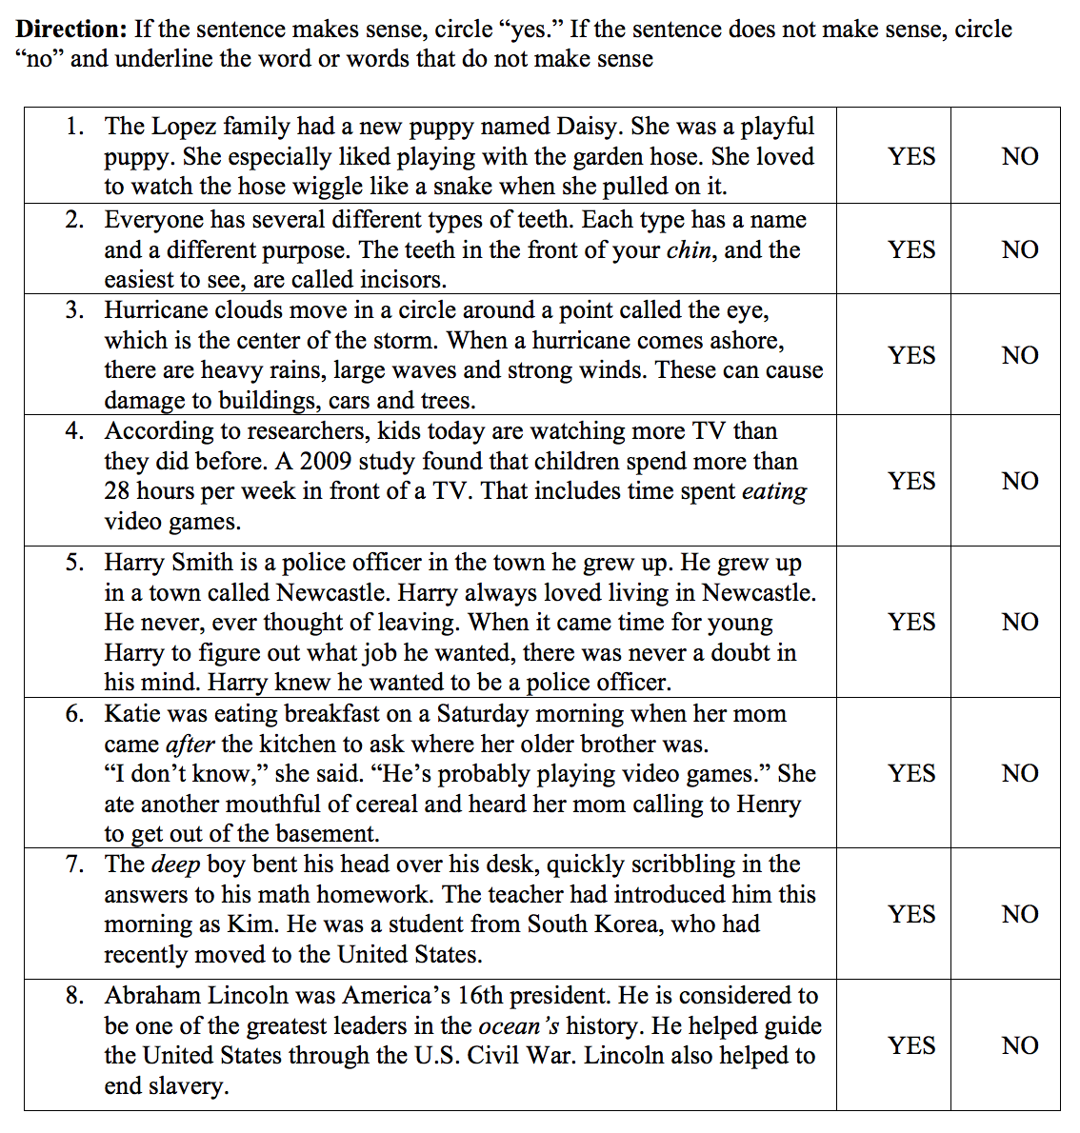
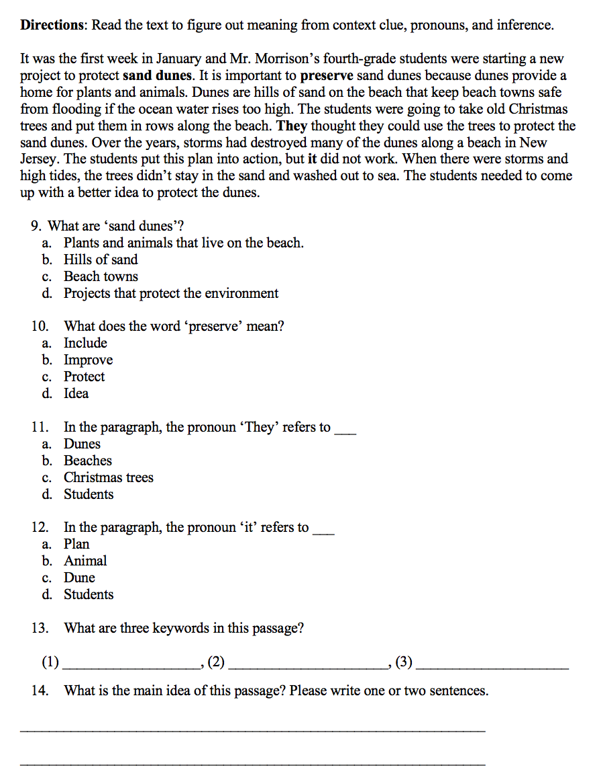
Researcher-developed Measure: MINI-RC

Slide 43
Anxiety Measures
Beck Youth Inventory Second Edition Anxiety Scale (BYI Anxiety)
Multidimensional Anxiety Scale for Children (MASC) Physical Symptoms
MASC: Social Anxiety
Reading Anxiety (Grills et al., 2014)

Slide 44
Data Analysis
Modeled the full and partial nesting in the data (nesting in interventionist only in treatment conditions)
Modeled pretest scores for each outcome as covariate
Controlled for family-wise error associated with multiple comparisons (Benjamini & Hochberg, 1995), two primary contrasts were evaluated:
  RANX vs BAU
  RANX vs RMATH

Slide 45
Effects on Reading Outcomes

Slide 46
Reading: Descriptive Data

Slide 47
Reading: Descriptive Data

Slide 48
Reading: Descriptive Data

Slide 49
Reading: Descriptive Data

Slide 50
Reading: Descriptive Data

Slide 51
Reading: Effect Sizes
Test | Contrast | Effect size (ES)
TOWRE-SW | RANX vs. BAU | 0.14
Mini-RC | RANX vs. BAU | 1.22
TOSREC | RANX vs. BAU | 0.24
KTEA-3 RC | RANX vs. BAU | 0.24
GMRT-RC | RANX vs. BAU | 0.01

Slide 52
Reading: Effect Sizes
Test | Contrast | ES
TOWRE-SW | RANX vs. BAU RANX vs. RMATH | 0.14 0.22
Mini-RC | RANX vs. BAU RANX vs. RMATH | 1.22 0.77
TOSREC | RANX vs. BAU RANX vs. RMATH | 0.24 0.10
KTEA-3 RC | RANX vs. BAU RANX vs. RMATH | 0.24 0.06
GMRT-RC | RANX vs. BAU RANX vs. RMATH | 0.01 0.18

Slide 53
Reading: Effect Sizes
Test | Contrast | ES
TOWRE-SW | RANX vs. BAU RANX vs. RMATH | 0.14 0.22
Mini-RC | RANX vs. BAU RANX vs. RMATH | 1.22* 0.77*
TOSREC | RANX vs. BAU RANX vs. RMATH | 0.24 0.10
KTEA-3 RC | RANX vs. BAU RANX vs. RMATH | 0.24 0.06
GMRT-RC | RANX vs. BAU RANX vs. RMATH | 0.01 0.18

Slide 54
Reading: Findings
Regardless of researcher or school provided treatment, students appeared to show gains in reading across most measures
Gains were comparable to those yielded in previous interventions with upper elementary struggling readers (Wanzek et al., 2013)
It may be necessary to provide more intensive interventions (e.g., smaller groups, more frequent use of data to inform instruction) for some students to remediate reading difficulties or align reading interventions with evidence-based Tier 1 instruction

Slide 55
Effects on Anxiety Outcomes

Slide 56
Anxiety: Descriptive Data

Slide 57
Anxiety: Descriptive Data

Slide 58
Anxiety: Descriptive Data

Slide 59
Anxiety: Descriptive Data

Slide 60
Anxiety: Effect Sizes
Test | Contrast | ES
BYI Anxiety Scale | RANX vs. BAU | -0.48
MASC Physical Symptoms | RANX vs. BAU | -0.22
MASC Social Anxiety | RANX vs. BAU | -0.61
Reading Anxiety | RANX vs. BAU | -0.28

Slide 61
Anxiety: Effect Sizes
Test | Contrast | ES
BYI Anxiety Scale | RANX vs. BAU RANX vs. RMATH | -0.48 -0.09
MASC Physical symptoms | RANX vs. BAU RANX vs. RMATH | -0.22 0.02
MASC Social Anxiety | RANX vs. BAU RANX vs. RMATH | -0.61 -0.41
Reading Anxiety | RANX vs. BAU RANX vs. RMATH | -0.28 -0.20

Slide 62
Anxiety: Effect Sizes
Test | Contrast | ES
BYI Anxiety Scale | RANX vs. BAU RANX vs. RMATH | -0.48* -0.09
MASC Physical symptoms | RANX vs. BAU RANX vs. RMATH | -0.22 0.02
MASC Social Anxiety | RANX vs. BAU RANX vs. RMATH | -0.61* -0.41*
Reading Anxiety | RANX vs. BAU RANX vs. RMATH | -0.28 -0.20

Slide 63
Anxiety: Findings
Additional research is needed, but the pattern of effect sizes underscores the promise of the RANX intervention.
The decreases in anxiety reported for students in the RMATH warrant further study.

